Slide 1

VOLCANO ART PRIZE 2017
Awards Ceremony – Winners

Slide 2
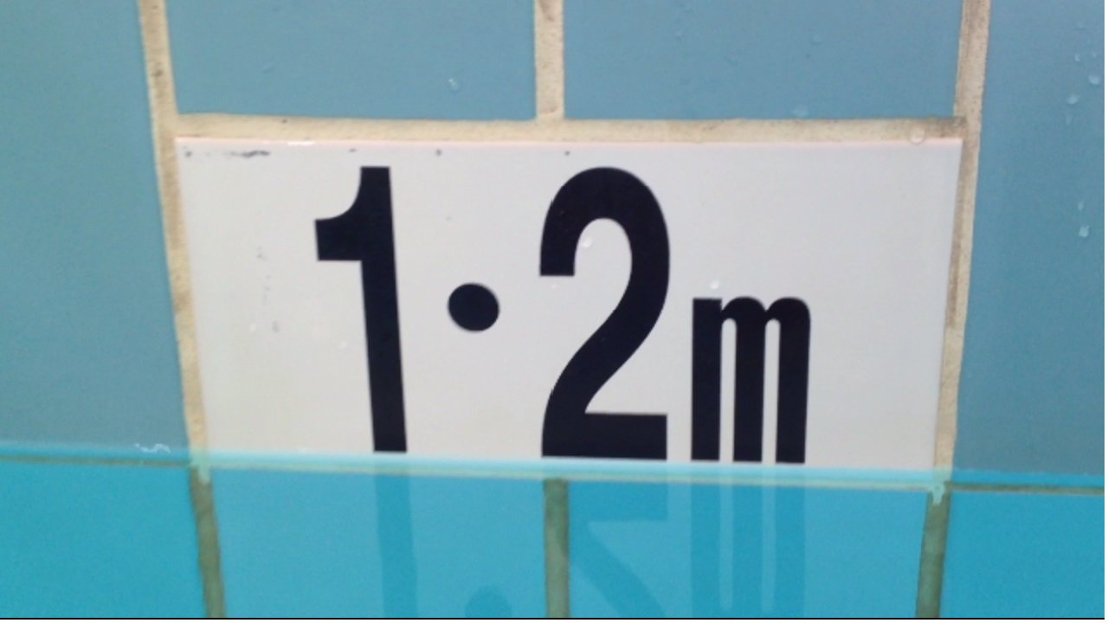
Entries Highly Commended by the Judge
Artists: Elizabeth O’Brien (text, film & voice), Ian Smith (soundtrack), Poornima Murthy (editor) Title: 1.2 million
Lead-safety Message: The LEAD Group's target for 2018 is that 1.2 million people ask their doctor for a blood lead test and start to reduce their body burden of lead.
http://volcanoartprize.com/portfolio-item/1.2-million/
https://www.youtube.com/watch?v=SgtTm1p-JDc

Slide 3
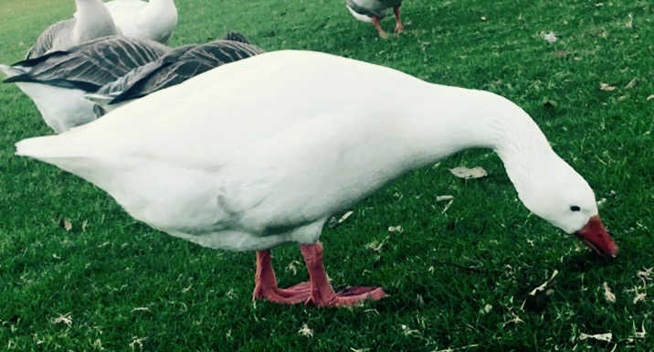
Artist: Claire O' Brien
Title: LUCY GOOSEY
Lead Safety Message: DON'T BE A GOOSE AND LET LEAD LOOSE.

Slide 4
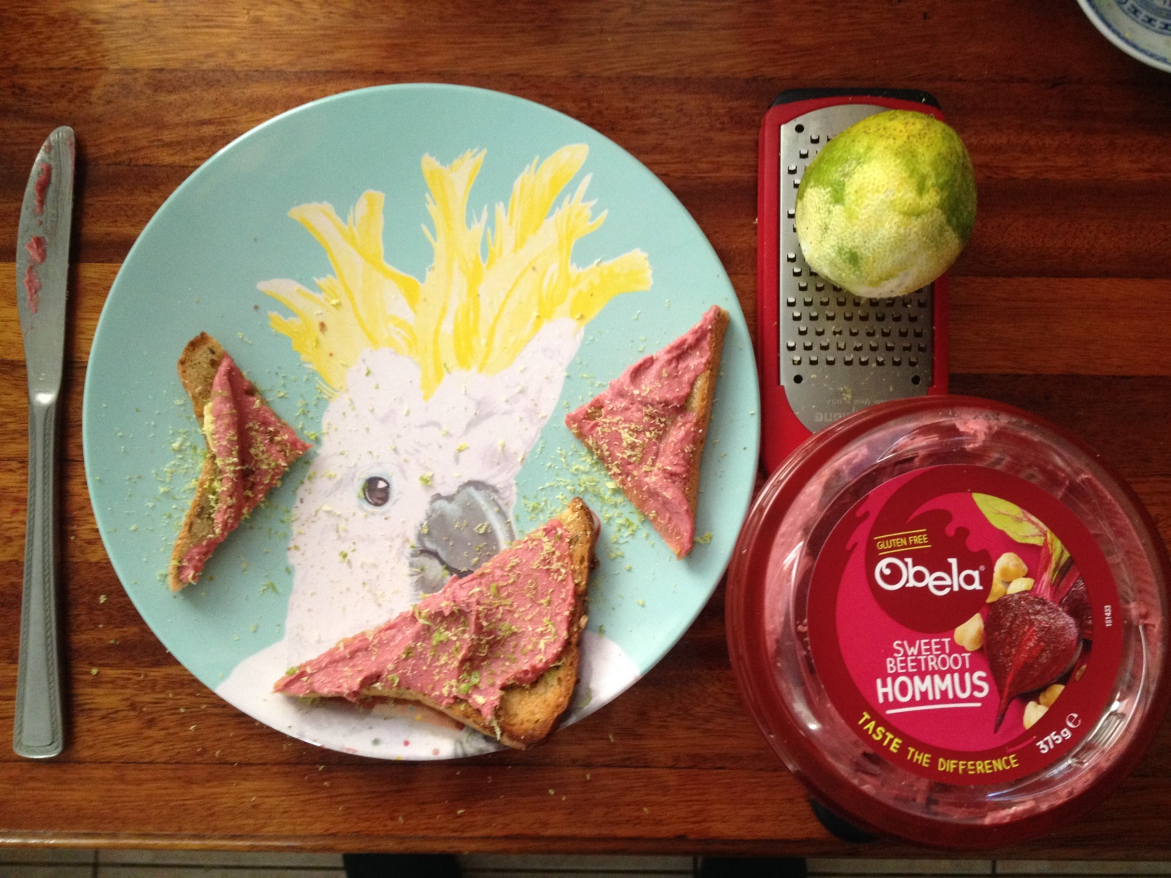
Artists: Olivia York (plate artwork) and Elizabeth O’Brien (photo)
Title: Lemon or lime zest - a grate addition to any plate!
Lead-safety Message: Adding fresh citrus zest to hot meals and salads is a Mediterranean tradition which turns out to be a great way to detox lead from the body.

Slide 5
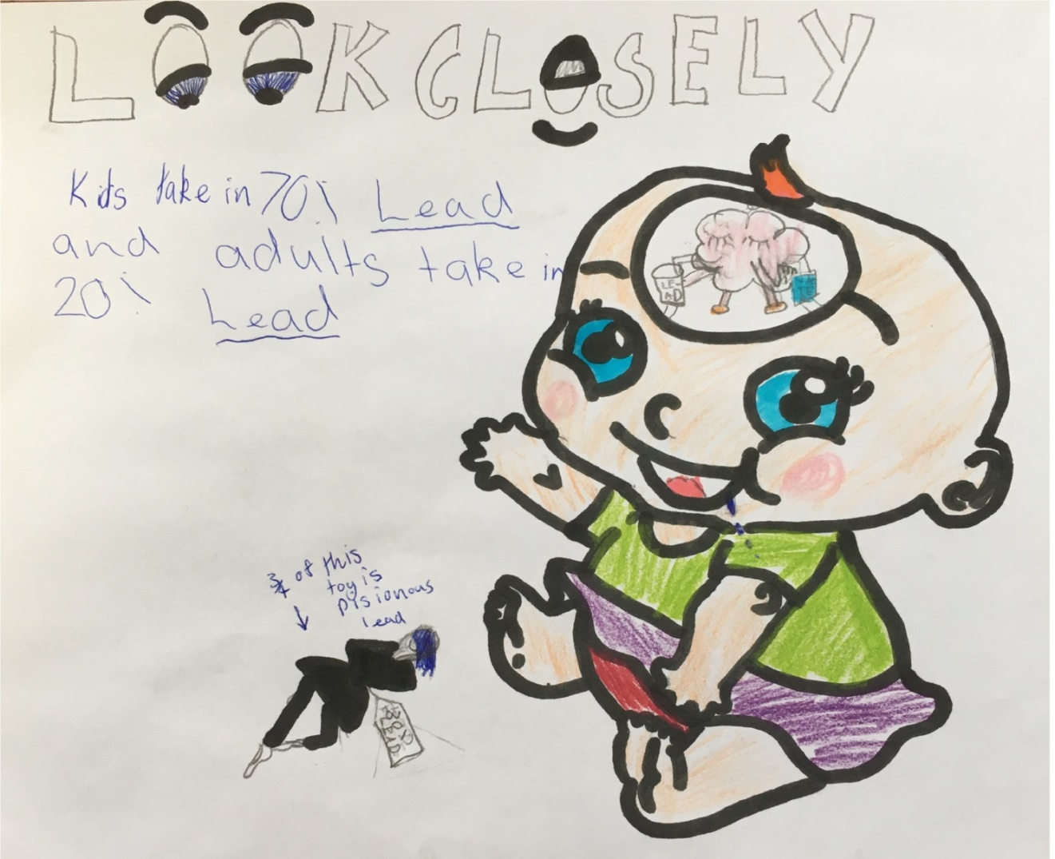
Winners of Pictureproducts mugs
Artist: Sophie Kilburn Title: Look Closely Age: 9 years
Lead-Safety Message: Kids take in 70% lead and adults take in 20%.

Slide 6
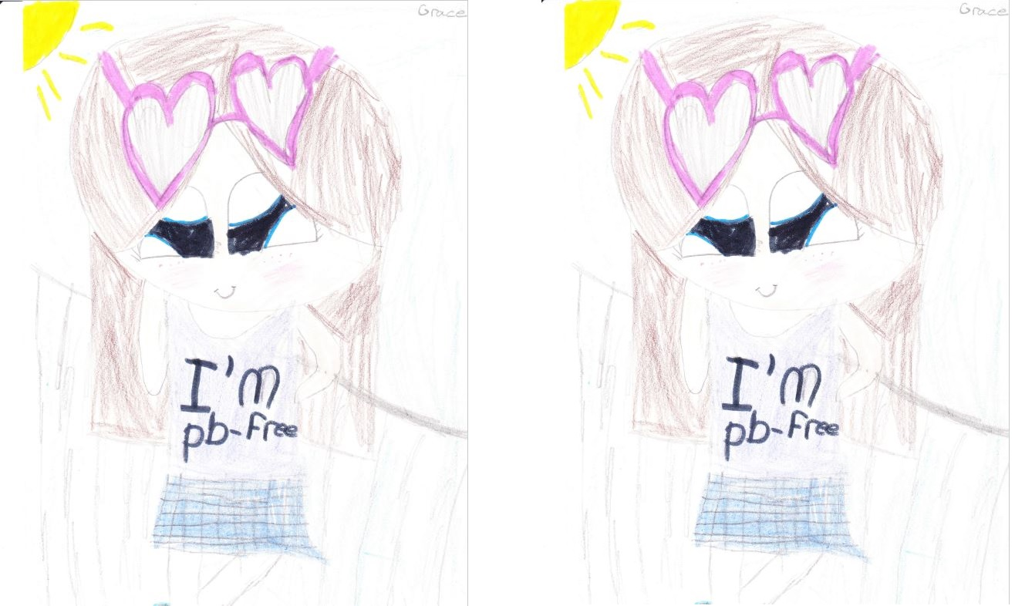
Artist: Grace King Matchett Title: Pb-free person Age: 9 years
Lead-Safety Message: Keep People Pb Free.

Slide 7
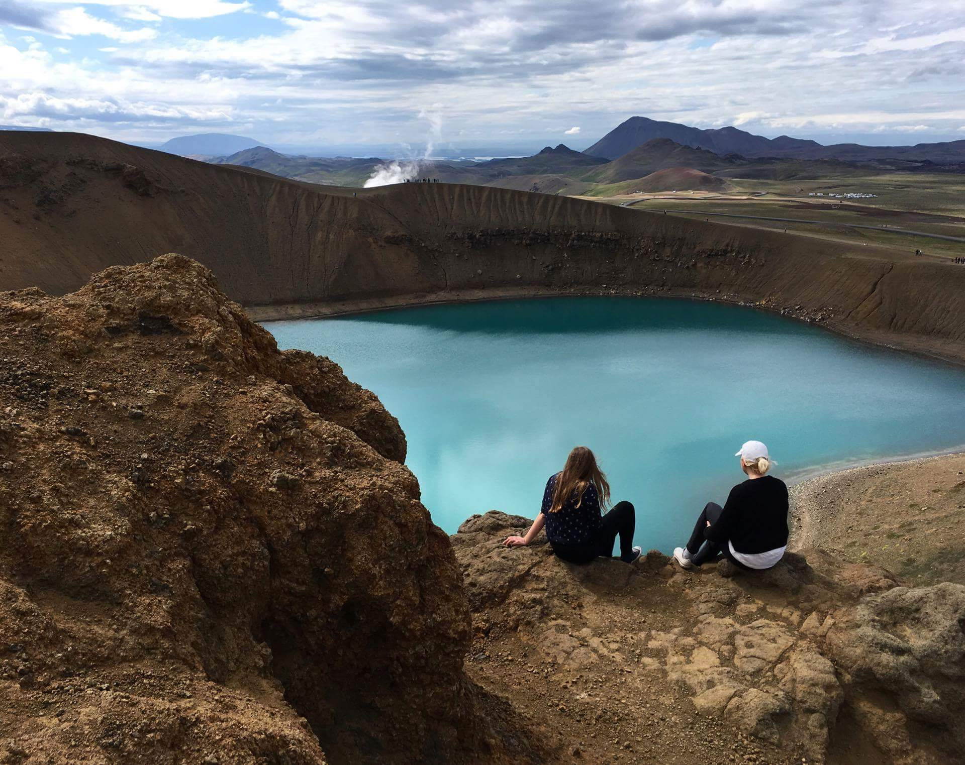
Artist: Harrison Desmond Title: Poisoned Pond
Lead-safety Message: This beautiful water in a volcanic crater in Iceland is likely full of lead and other heavy metals which reign down when volcanoes erupt.

Slide 8
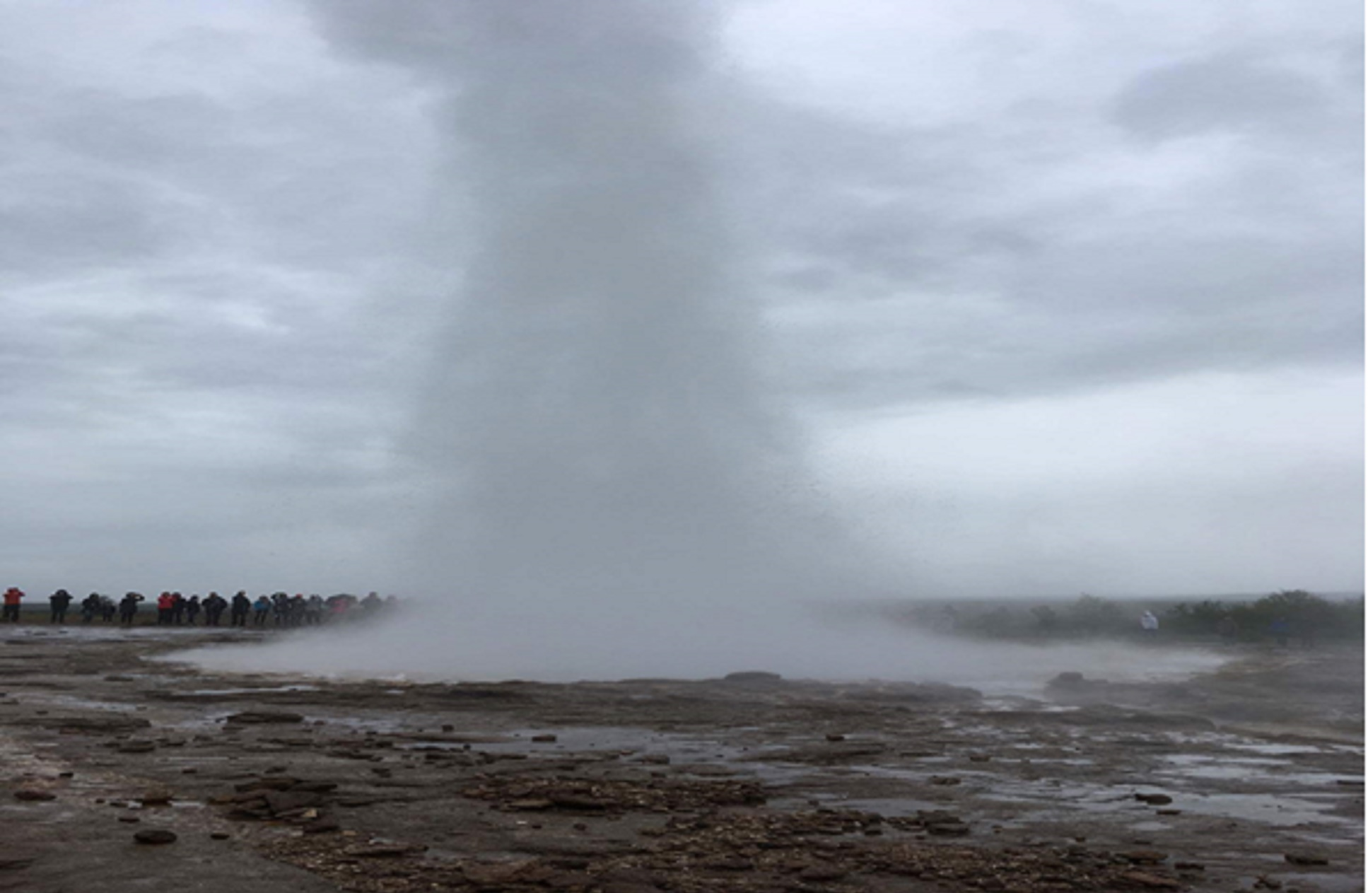
Artist: Emily Carpenter Title: Trapped
Lead-safety Message: This water geyser exploding in Iceland fills the air with mineral-laden water, hopefully not too.

Slide 9
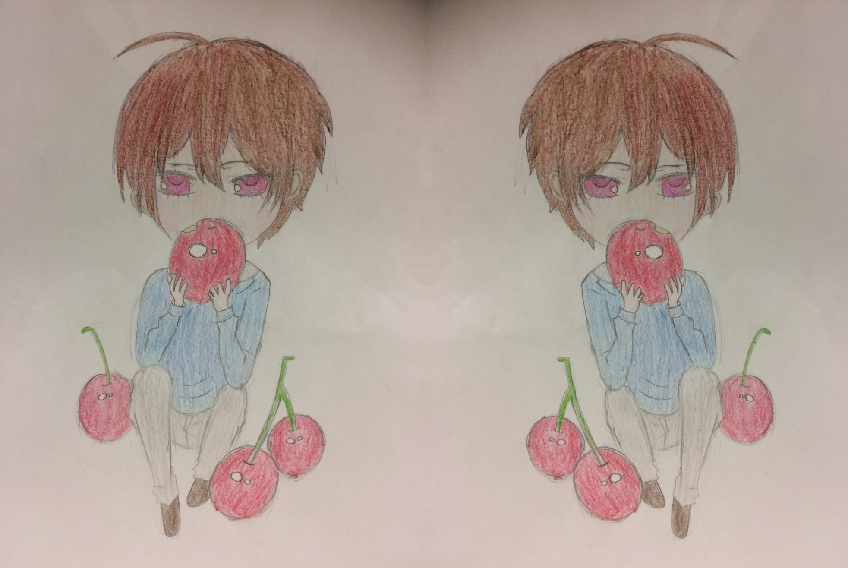
Artist: Cherry Qin Title: Kid eating apples Age: 12 years
Lead-Safety Message: A healthy apple a day keeps the lead away as it contains lots of pectin.

Slide 10
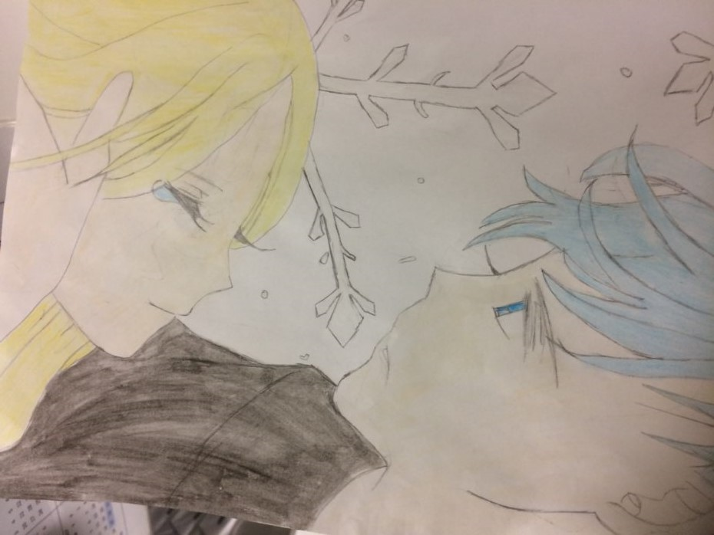
Artist: June He Title: Couple in love Age: 12 years
Lead-Safety Message: To live a long life with your loved one, be lead free

Slide 11
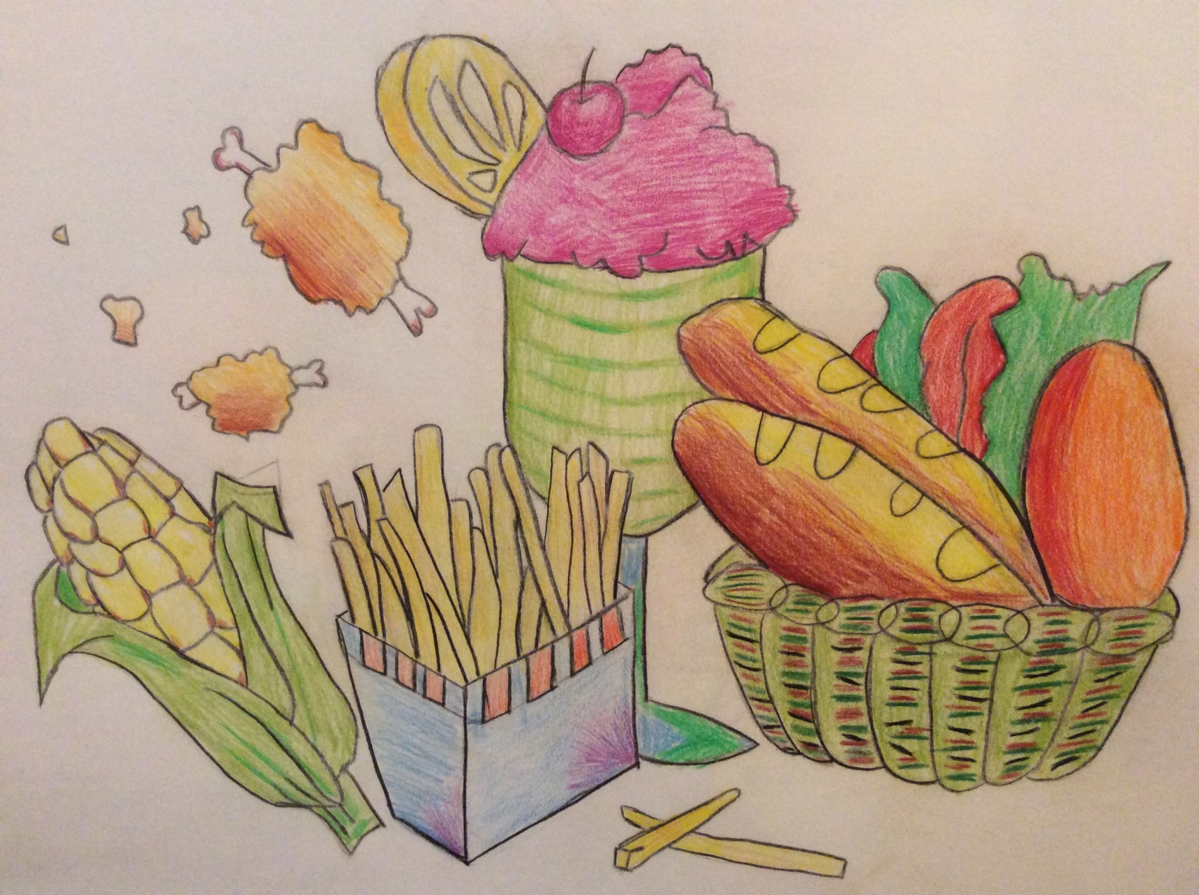
Artist: Mark Ju Title: Fast Food Age: 11 years
Lead-Safety Message: Watch out what you consume. Aim at lead free, healthy diet.

Slide 12
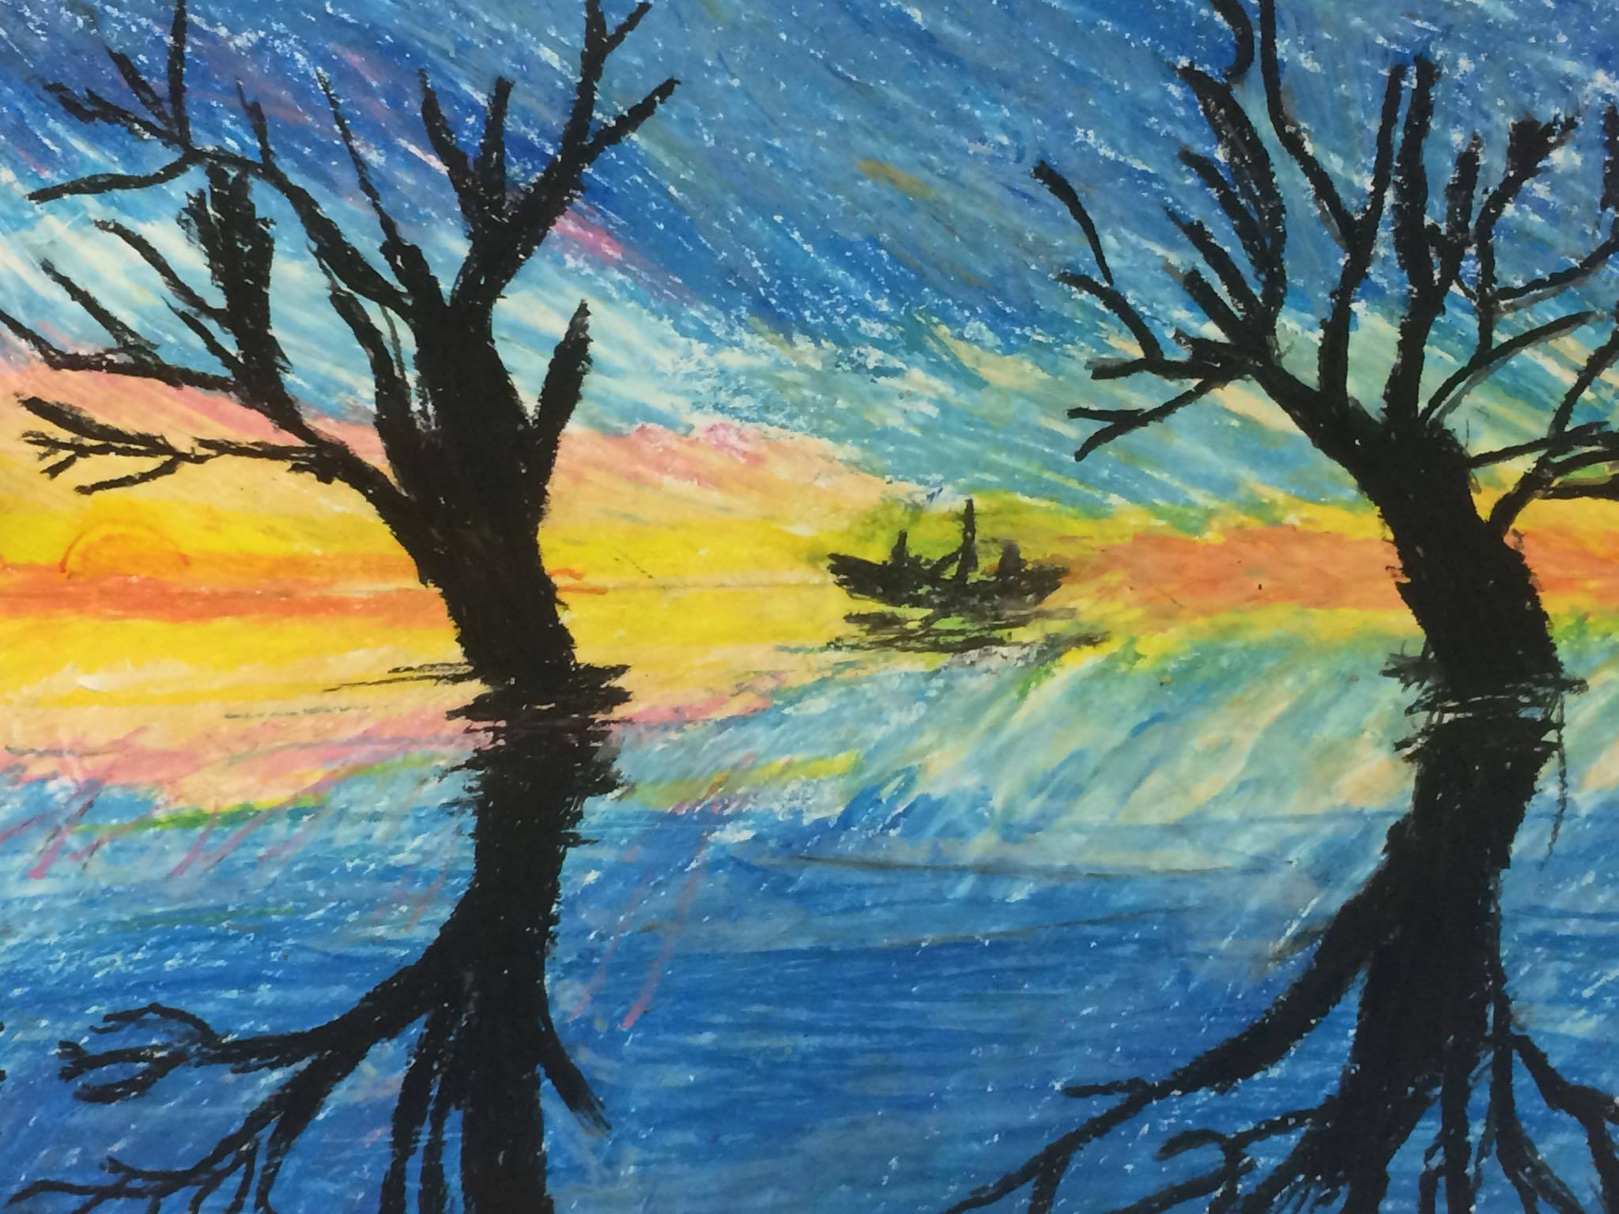
Artist: Li-Ke Shi Title: Boat in a lake Age: 10 years
Lead-Safety Message: Try not to add lead to water while fishing

Slide 13
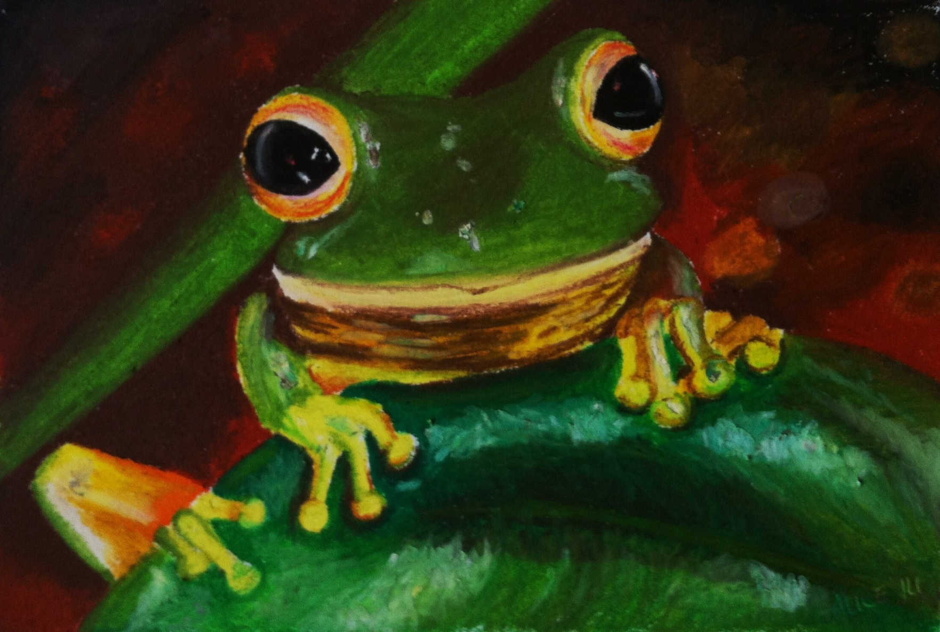
Artist: Alice Ju Title: Red eyed tree frog
Lead-Safety Message: Lead affects even the smallest of creatures.

Slide 14
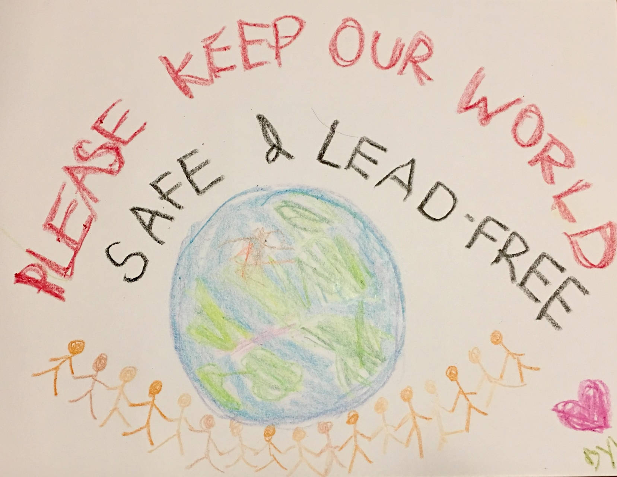
Artist: Dylan Andrew Hsieh Title: Keep our world safe Age: 4 years
Lead-Safety Message: Please keep our world safe and lead-free.

Slide 15
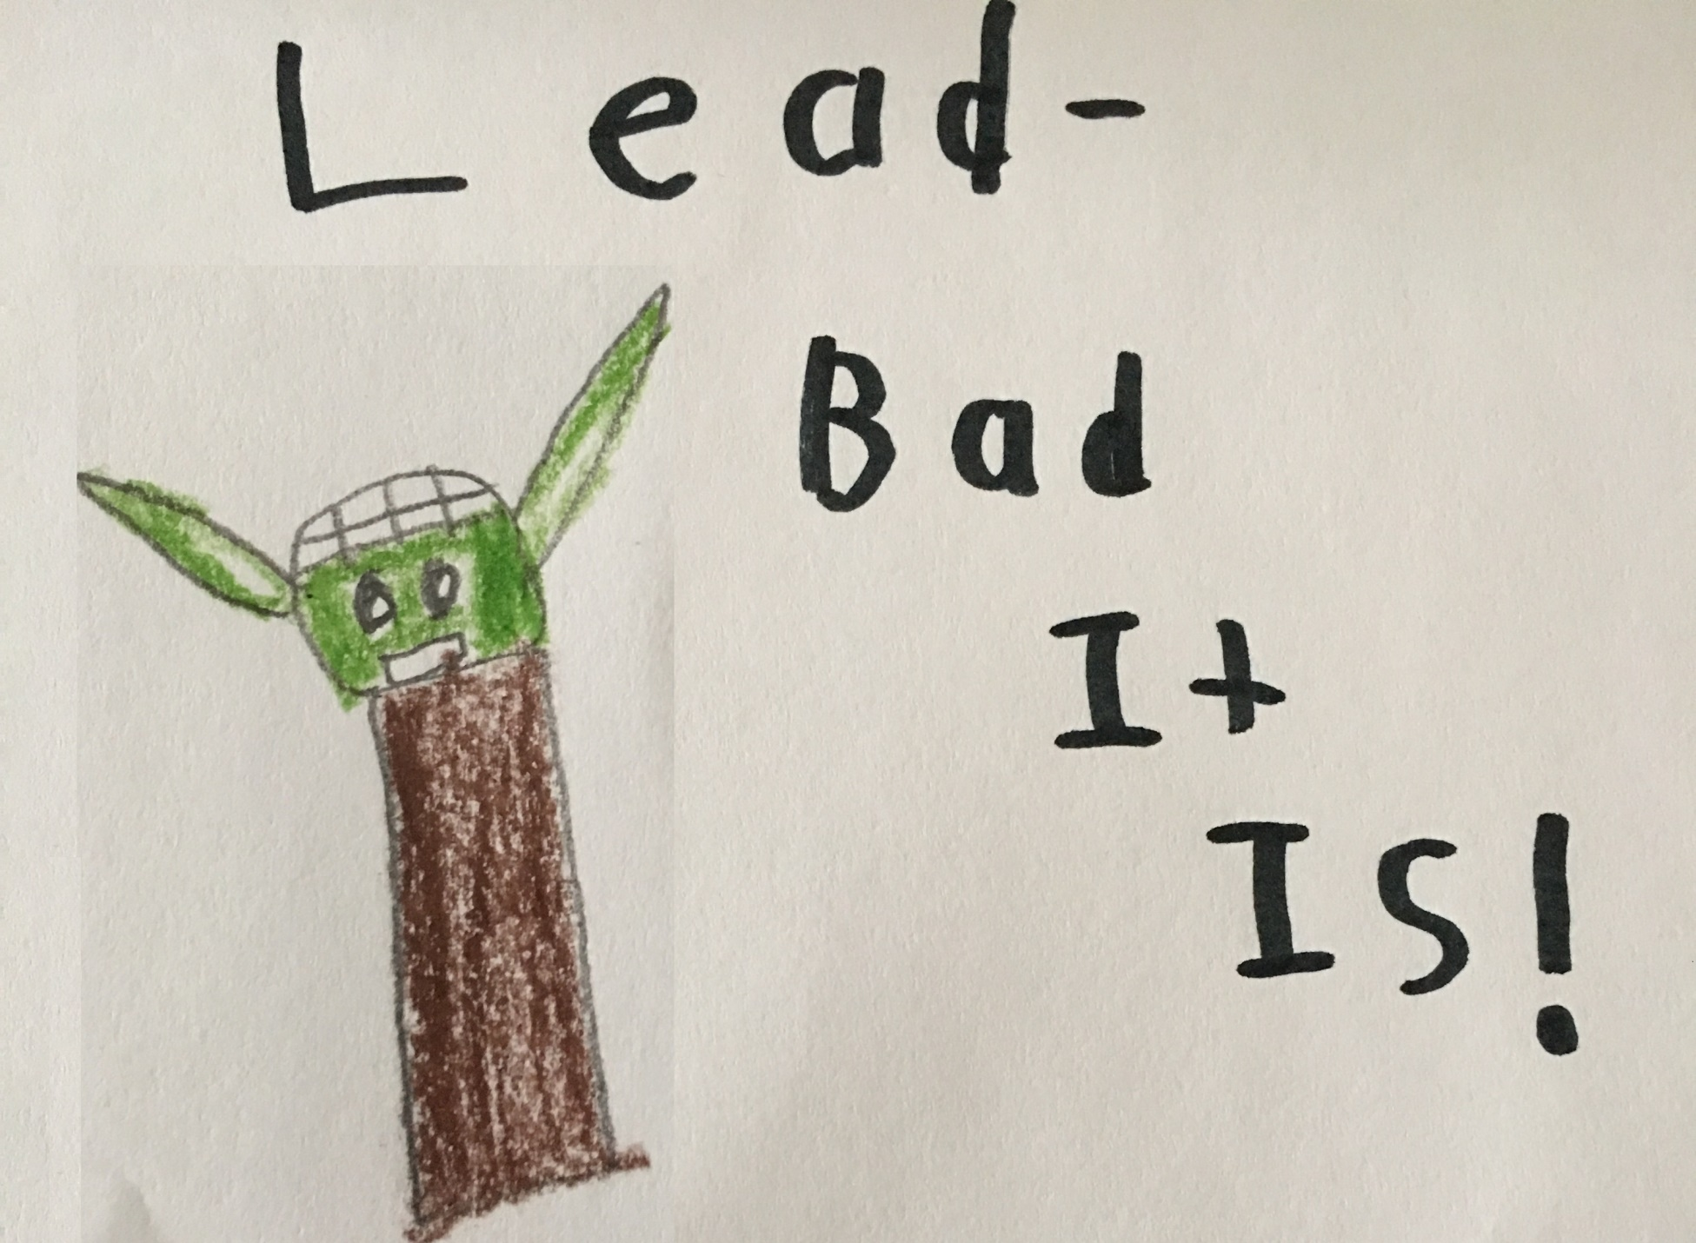
Artist: Kayson Parker Title: Yoda Wisdom Age: 9 years
Lead-Safety Message: Lead, bad it is!

Slide 16
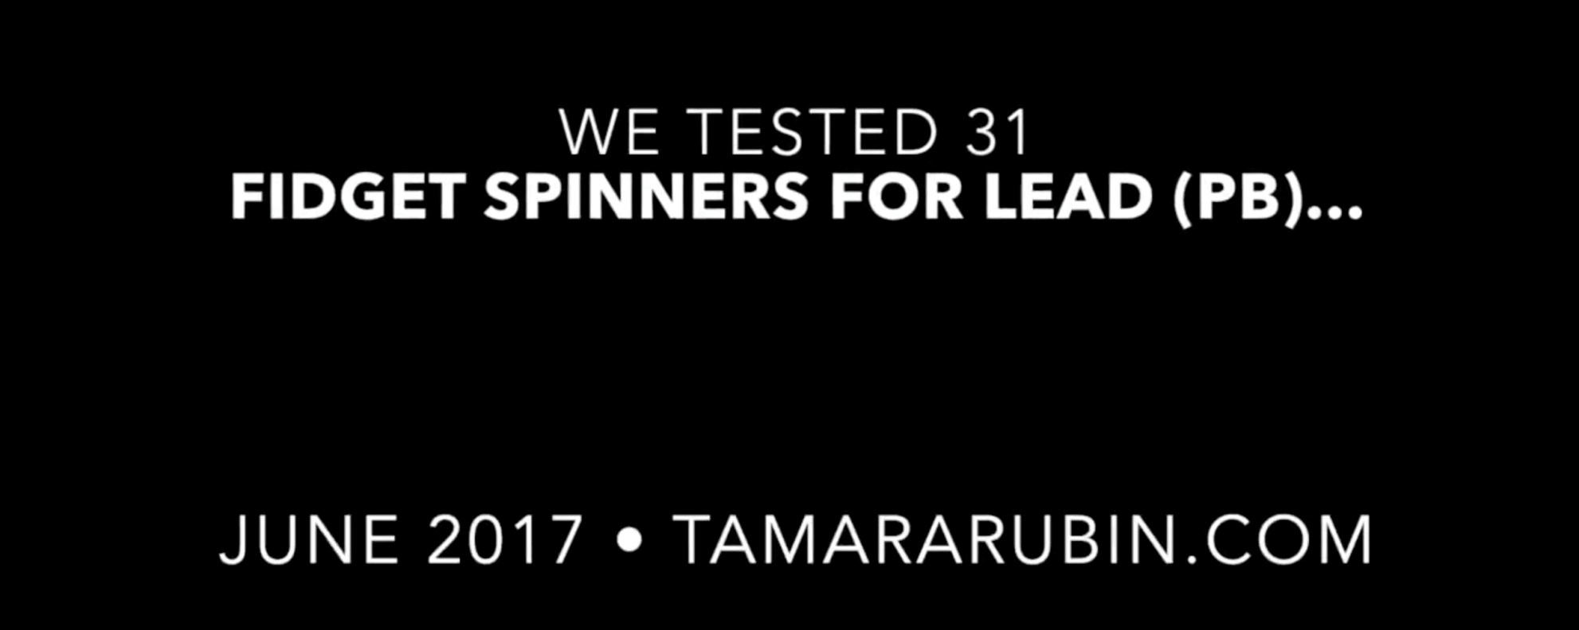
Artist: Tamara Rubin Title: Testing Fidget Spinners For Lead
Lead Safety Message: No level of lead is safe in a child's toy. https://vimeo.com/225702053 http://volcanoartprize.com/portfolio-item/testing-fidget-spinners-for-lead/

Slide 17
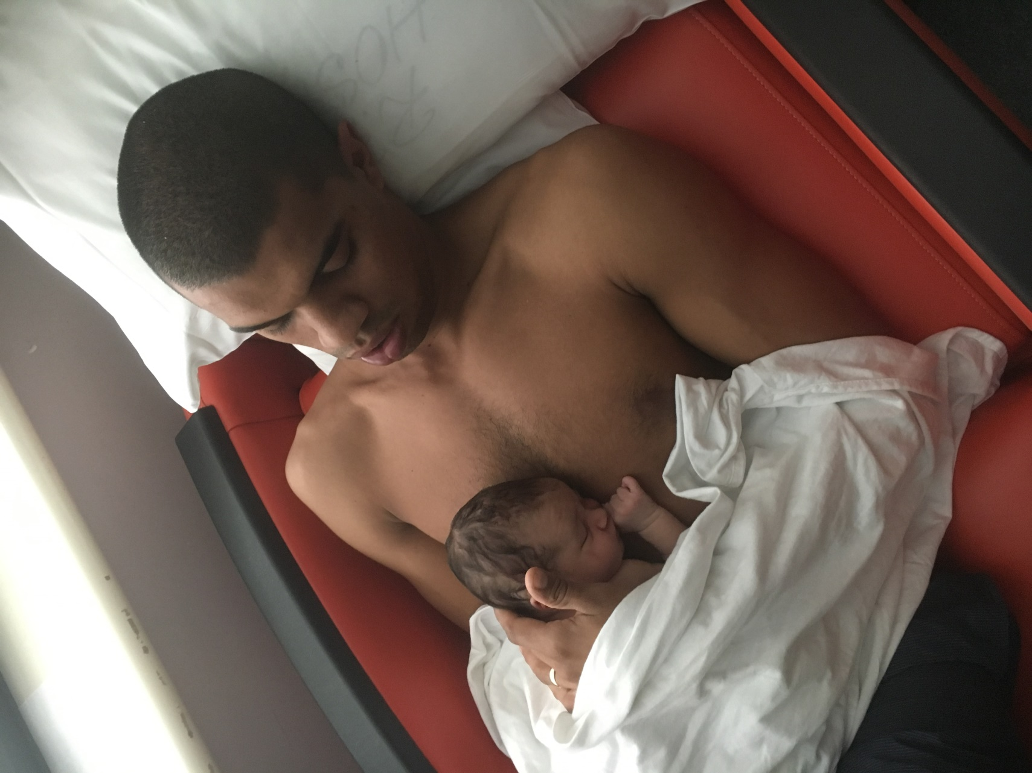
Artist: Violet Winters Title: Cycle of Life
Lead Safety Message: Our children deserve a clean world.

Slide 18
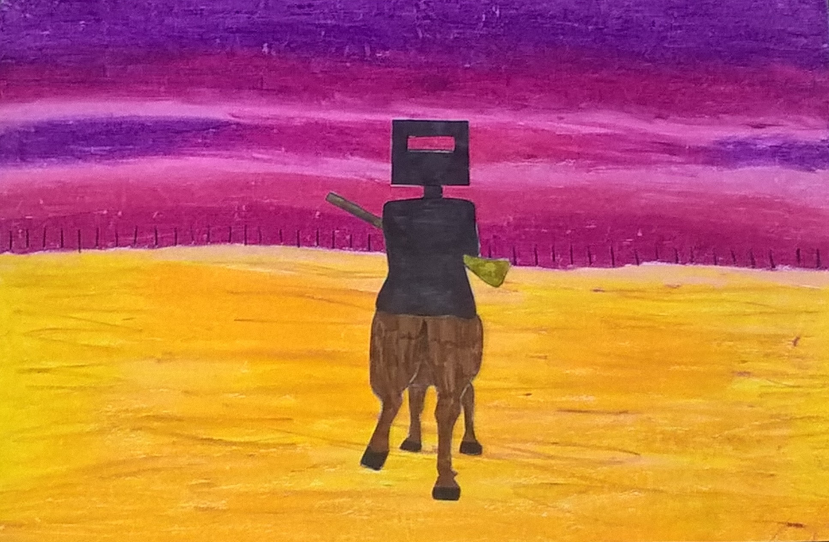
Artist: Ritishaa Sreedhar Title: Outback Age: 11 years
Lead Safety Message: Keep the outback lead free by not using leaded gun shot.

Slide 19
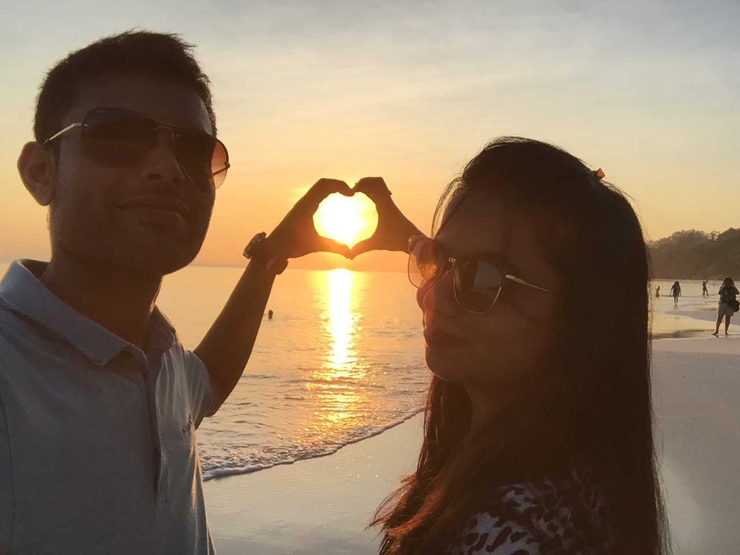
Artist: Ankit Patel Title: Love is in the lead safe world
Lead Safety Message: Love is in the lead safe world.

Slide 20
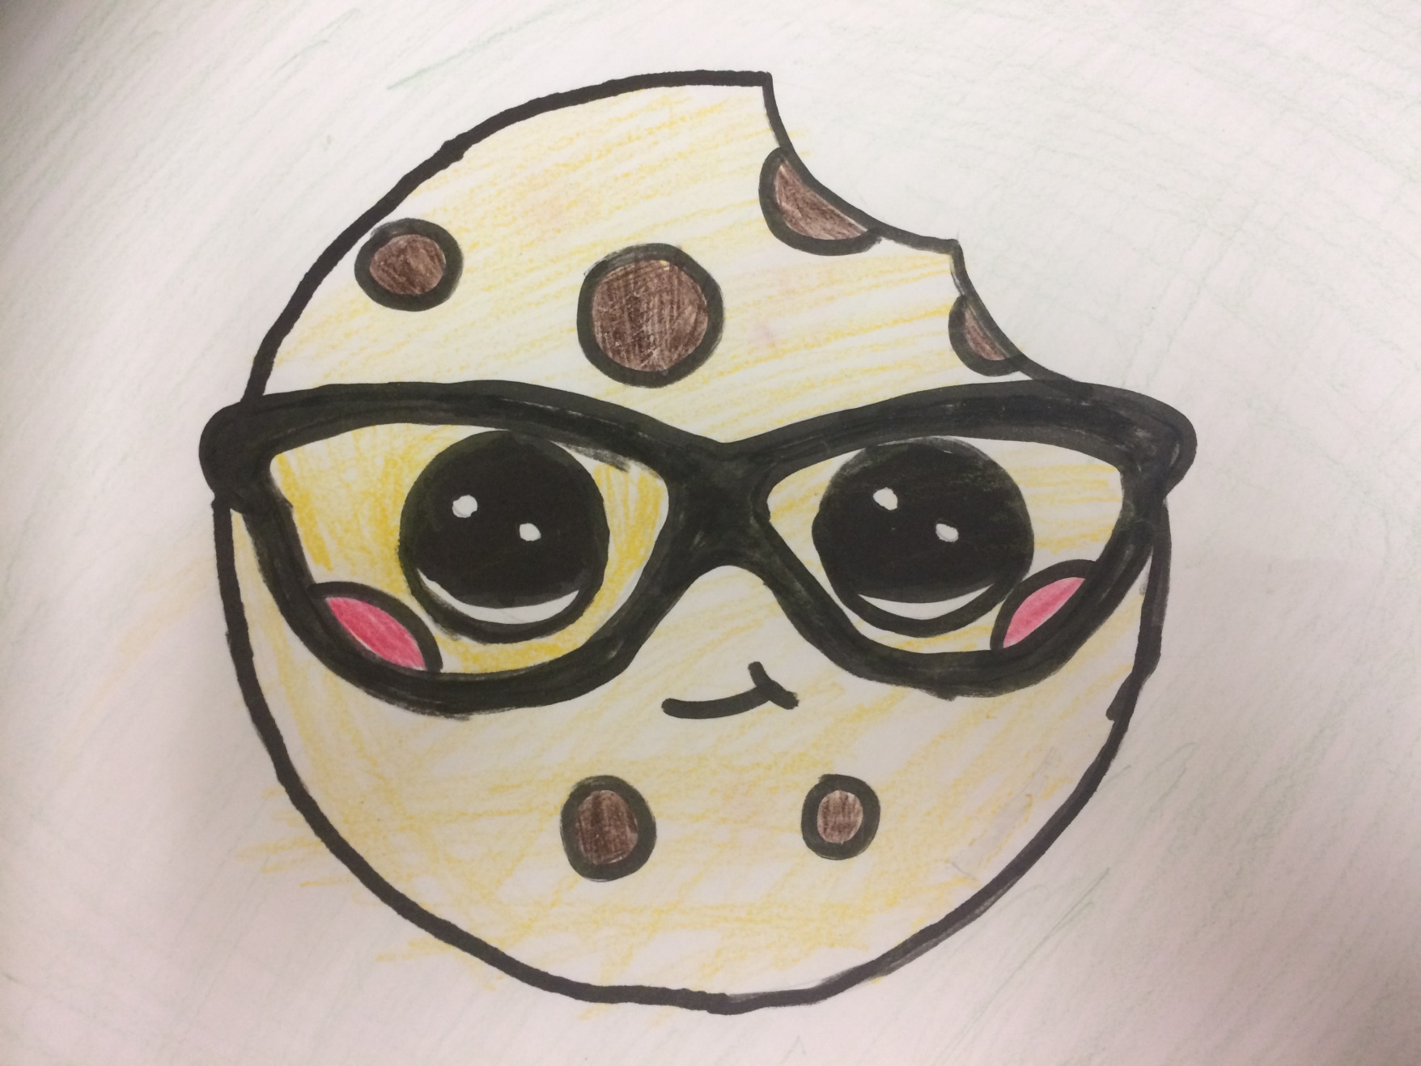
Artist: Cecile Chen Title: Cookie Age: 10 years
Lead Safety Message: Lead is the sweetest of poisons like Cookies

Slide 21
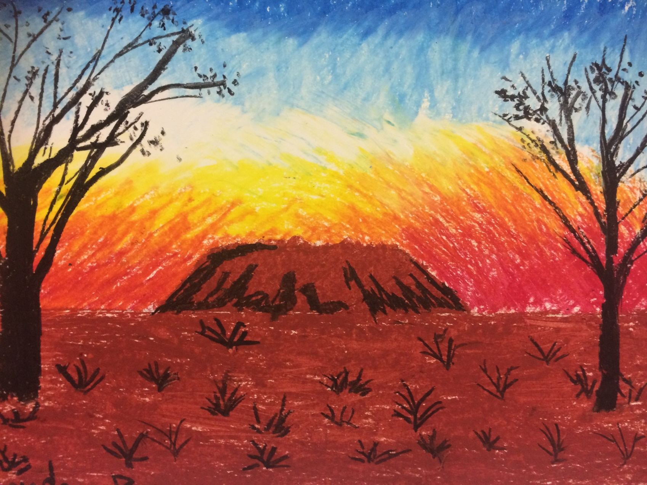
Artist: Sophea Wang Title: Uluru Age: 6 years
Lead Safety Message: Visit the heart of Australia but without poisoning it with lead.

Slide 22
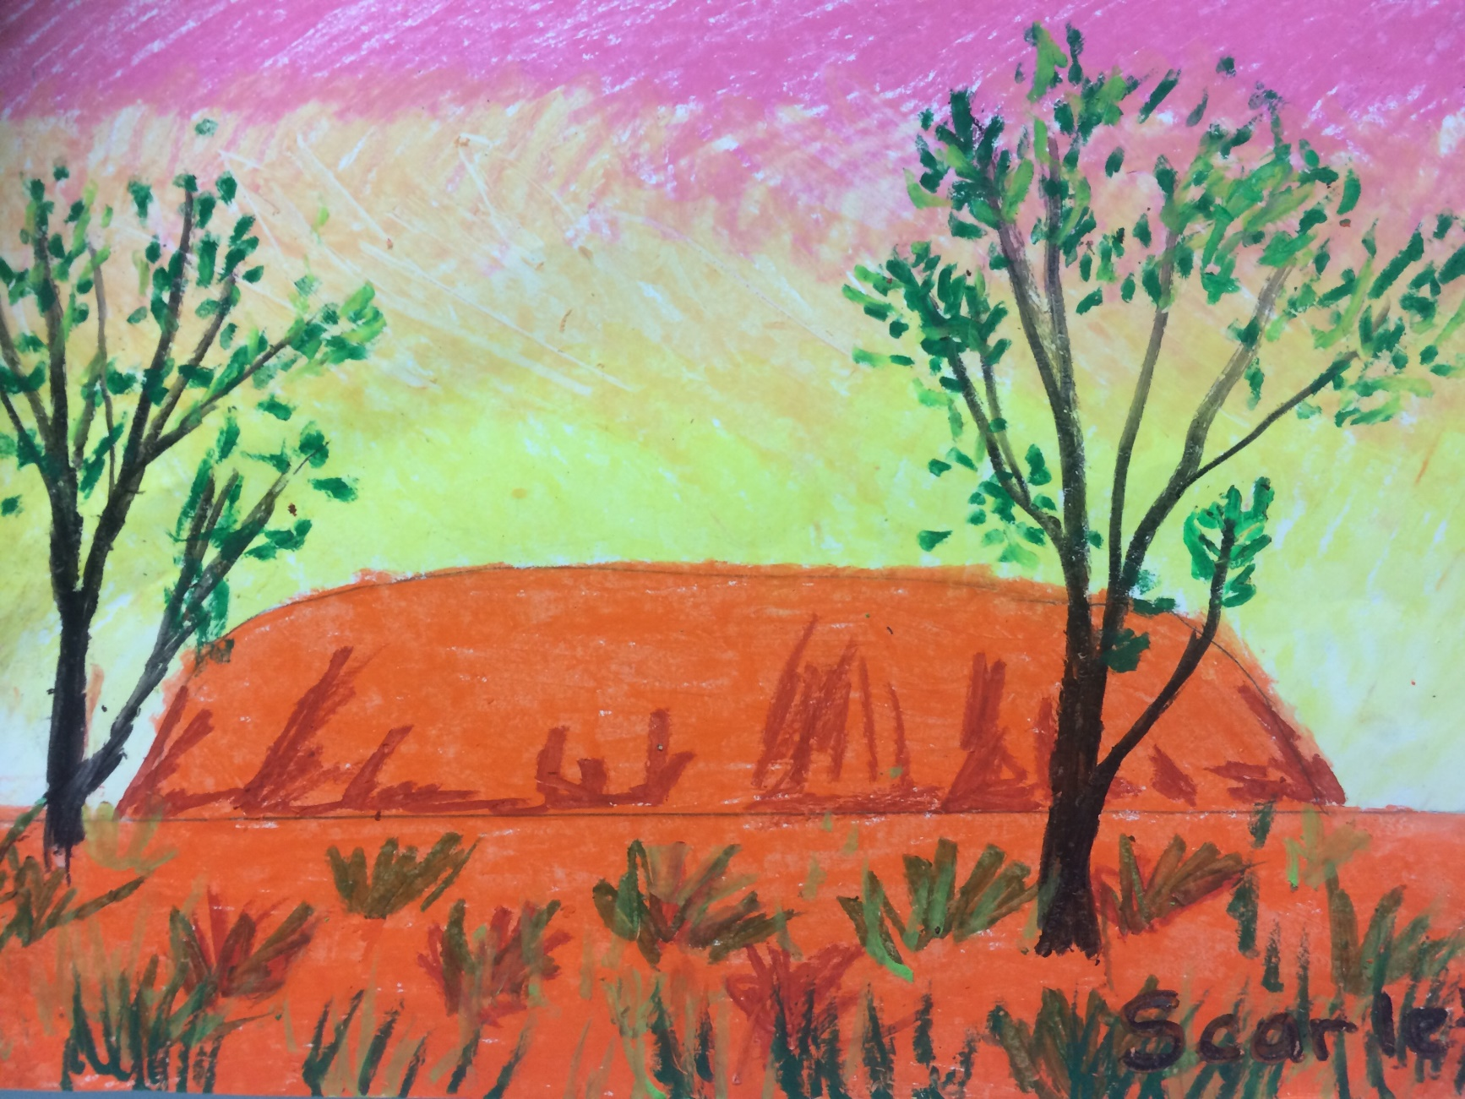
Artist: Scarlett Tran Title: Lead free Landscape Age: 9 years
Lead Safety Message: We must save our landscapes from lead poisoning.

Slide 23
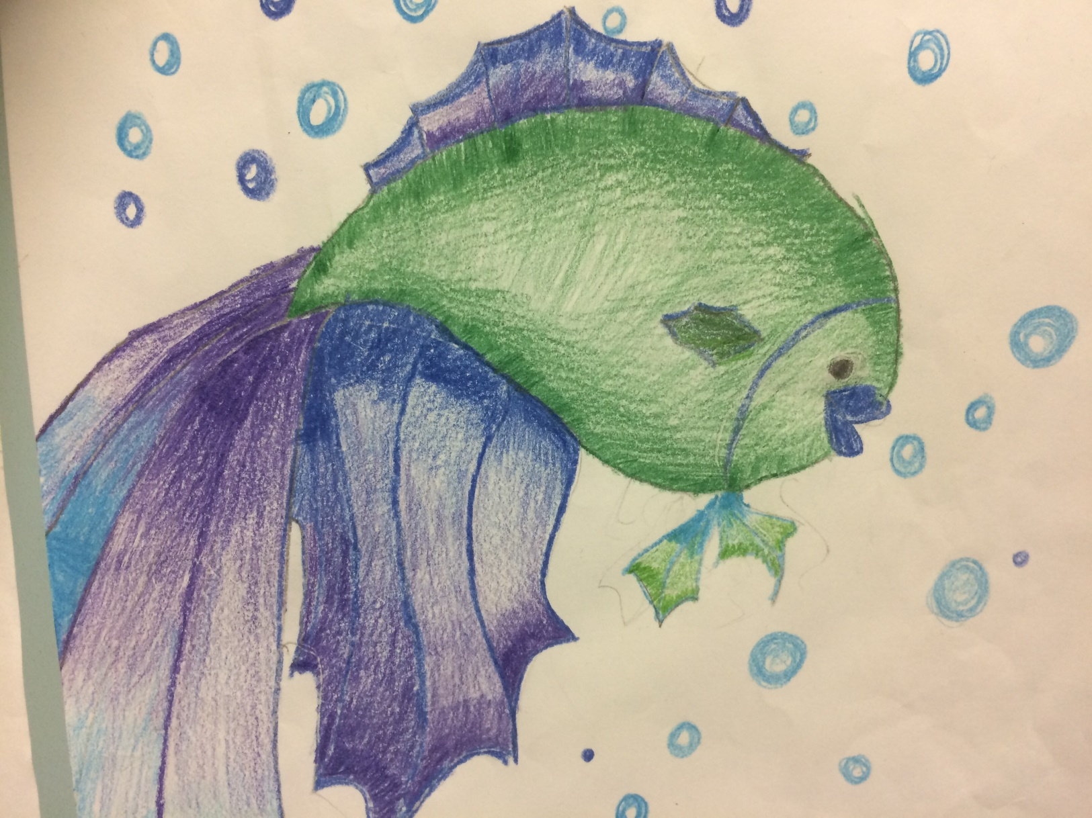
Artist: Brandon Banh Title: Aquatic Life Age: 10 years
Lead Safety Message: Lead contamination can harm aquatic life. We must protect the aquatic species.

Slide 24
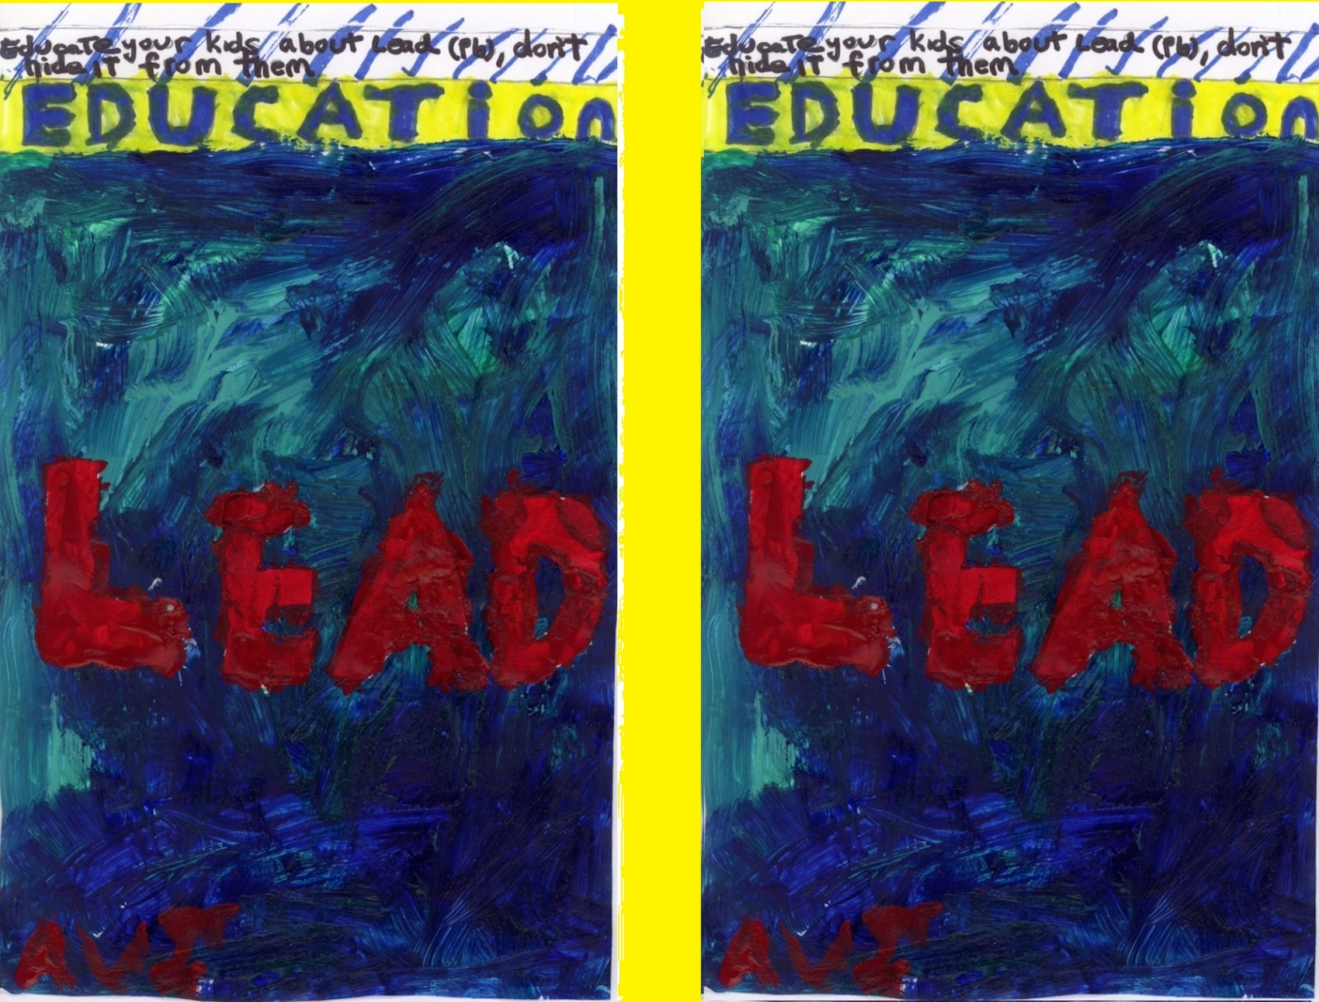
Artist: Avi Rubin Title: Educate Your Kids About Lead Age: 12 years.
Lead Safety Message: Educate your kids about lead (Pb), don't hide it from them.

Slide 25
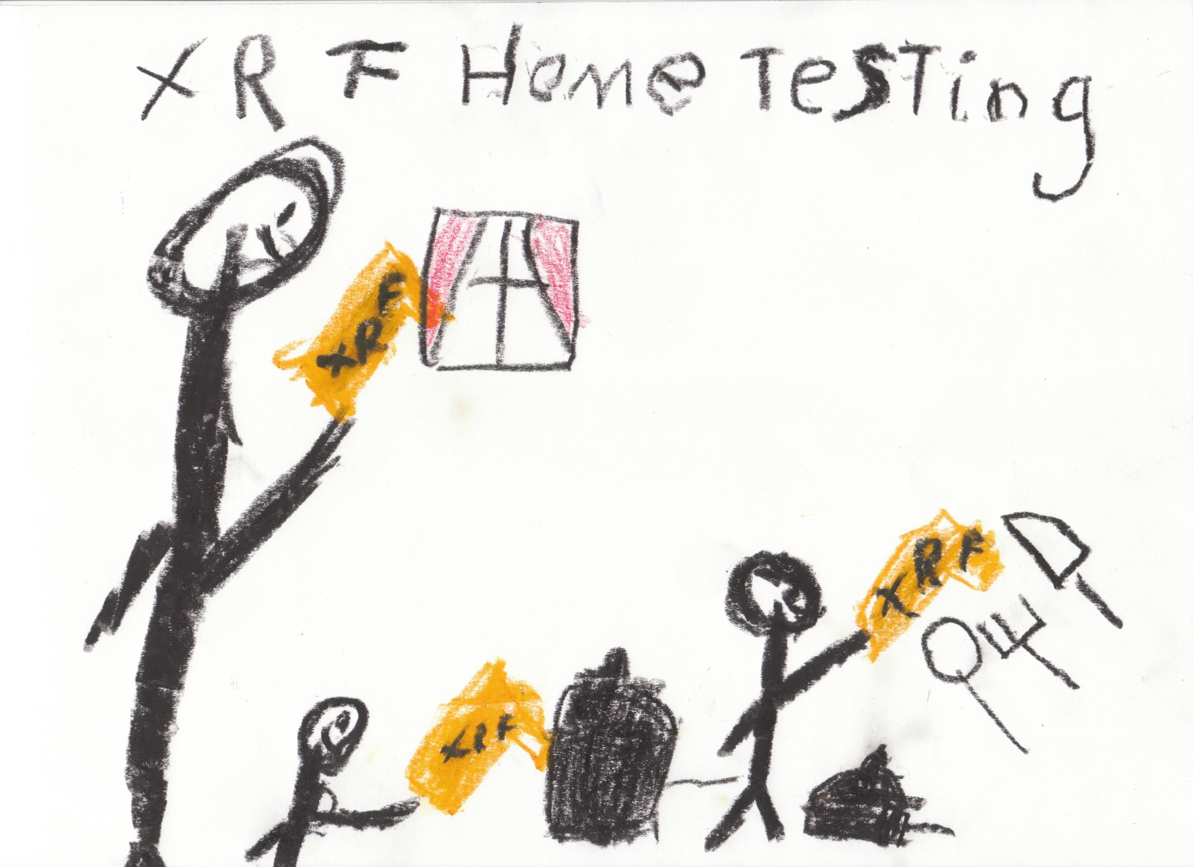
Artist: Kai D W Kehoe Toxic Pots and Pans, Utensils and Windows Age: 6.5 years
Lead Safety Message: For a better idea of lead sources, test home items with an XRF.

Slide 26
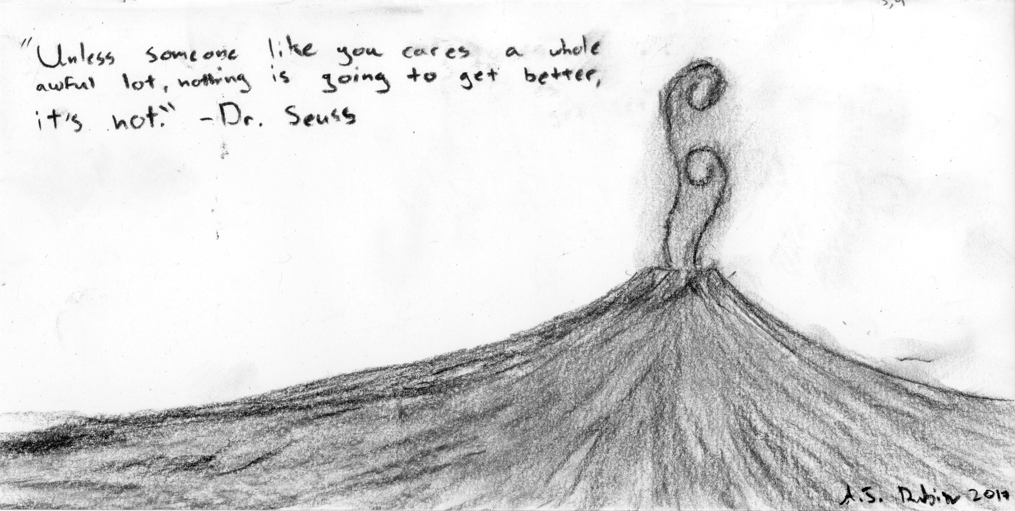
Artist: A.J. Rubin Title: Unless Age: 14 years
Lead Safety Message: Unless someone like you cares a whole awful lot, nothing is going to get better, it's not." - Dr. Seuss

Slide 27
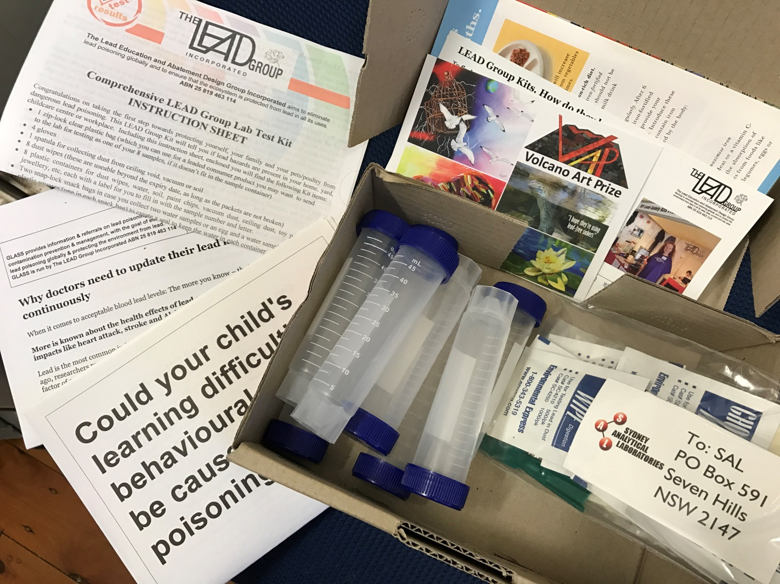
Artist: Demonstration and Video editing -Malveek Kaur Dhaliwal, Recording - Poornima Murthy
Title: The LEAD Group Kit's Dust Wipe in action!
Lead Safety Message: The LEAD Group Report will tell me if my floor is safe from lead for children and pets. http://volcanoartprize.com/portfolio-item/the-lead-group-kits-dust-wipe-in-action/ https://www.youtube.com/watch?v=poJQFjrJpKQ

Slide 28
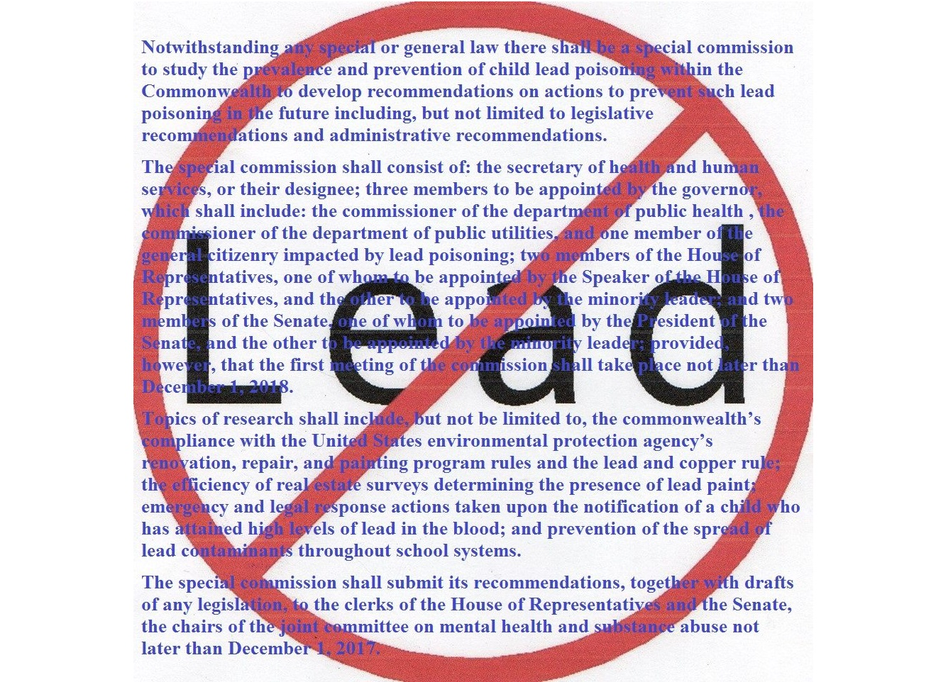
Artist: Kim Cole, Korey Nicolas Title: Massachusetts Legislature Bill SD.751
Lead safety Message: An Act creating a special commission to study the prevalence and prevention of child lead poisoning

Slide 29
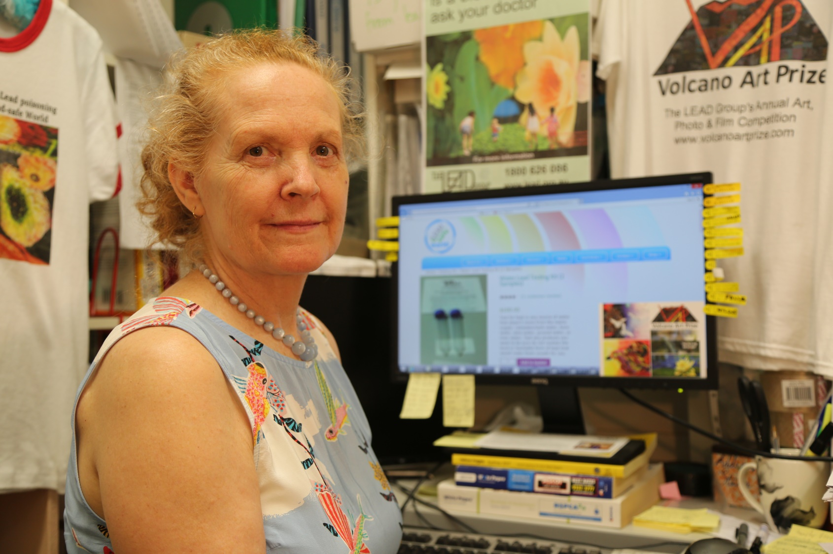
Photographer: Peter Kozaitis
Title: Elizabeth O'Brien at work in The LEAD Group's office
Lead-safety Message: Use a LEAD Group Water Kit to test for lead in water before you drink rainwater or water from new taps or new plumbing or your new home.

Slide 30
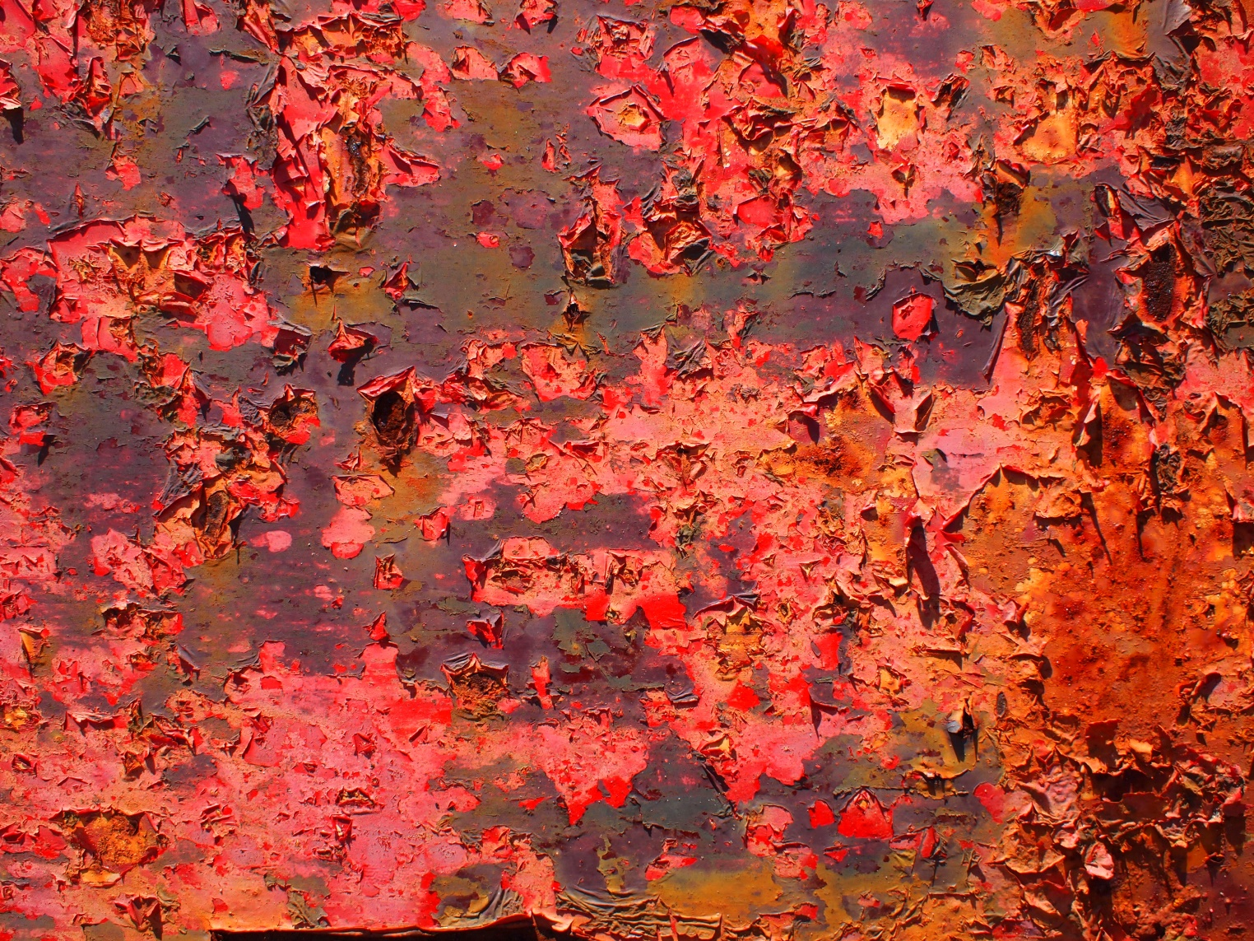
Artist / Photographer: Isla MacGregor
Title: Peeling lead paint polluting patios and potato patches
Lead-safety Message: Use a LEAD Group Kit to test for lead in peeling paint, dust, water and soil before you plant your potatoes or let your children play on the patio.

Slide 31
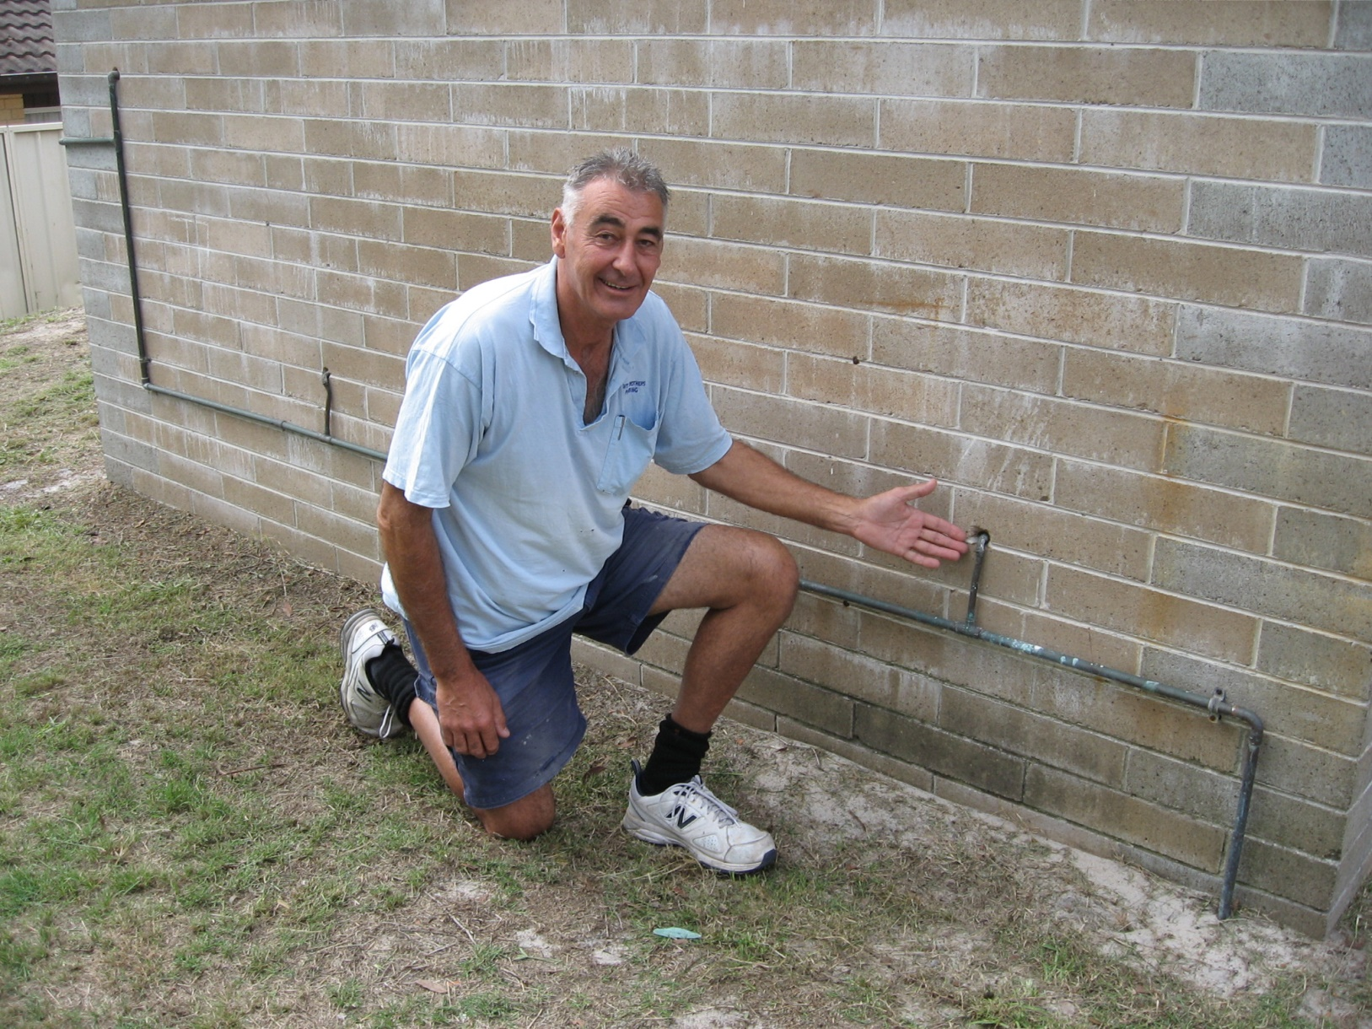
Artist / Photographer: Geoff Walker
Title: Lead Soldered Yorkshire Fittings
Lead-safety Message: Lemon Tree Passage Plumber Geoff Davey inspecting lead soldered ‘Yorkshire’ fittings at the local library March 2017.

Slide 32
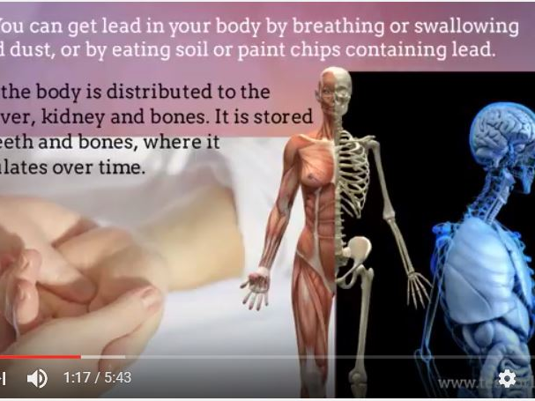
Judge-Awarded cash prize winner of VAP 2017
Artists: Faris Sheridan, Hesaan Sheridan (Film-makers)
Title: Lead in paint and varnish. The hidden dangers.
Lead-Safety Message: Before the dangers of lead were known, it was a common ingredient in house paint and varnish, where it acted as a pigment and increased durability and a drying agent. Millions of homes, schools and businesses still have lead based paint on their walls, both inside and out. If the paint is in good condition and has been painted over, it usually doesn’t pose a problem. But if the paint is peeling or has been disturbed by scraping, sanding, or burning, it can pose significant health risks to people and pets, especially young children.
http://volcanoartprize.com/portfolio-item/lead-group-video/
https://www.youtube.com/watch?v=z3Zk0JepSNg&feature=youtu.be

Slide 33

People’s Choice cash prize winner of VAP 2017
Artist: Poornima Murthy
Title: Champagne Beach, Vanuatu
Lead-safety Message: To preserve nature's pristine beaches and the colourful fishes, don't discard leaded items into the ocean. Being lead free adds years to one's life.

Slide 34
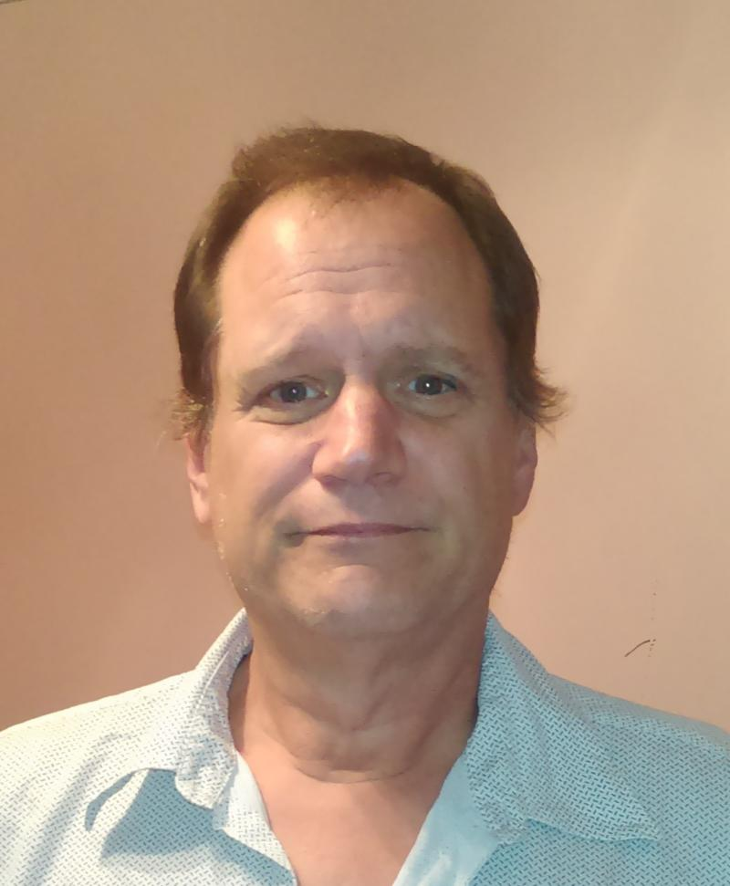
The Judge, WAYNE ASKEW
Thank you for making such a thoughtful selection of winners from all our wonderful entries and their lead safety messages. And thank you for dedicating your life to raising awareness of the truth about lead.

Slide 35


ACKNOWLEDGEMENT
Thanks to our wonderful sponsor Toby Griffin of Pictureproducts who provided the 30 mug prizes.
Thanks to Pia Brabek of Summer Hill Toastmasters for her professional MCing of the awards ceremony.
From the Volcano Art Prize 2017 graphics and events team:
Elizabeth O’Brien
Rekha Vasudev
Poornima Murthy
Malveek Dhaliwal

